Slide 1
Descriptive Analytics
A/B testing and Discrete Choice Experiments

Slide 2
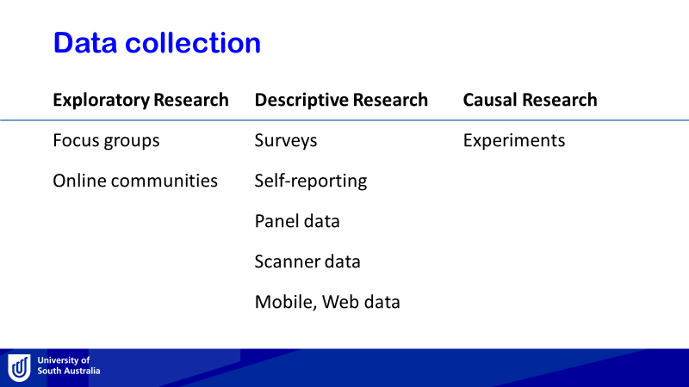
Last week topic review
Correlation VS Causation - Causation from data analysis

Slide 3
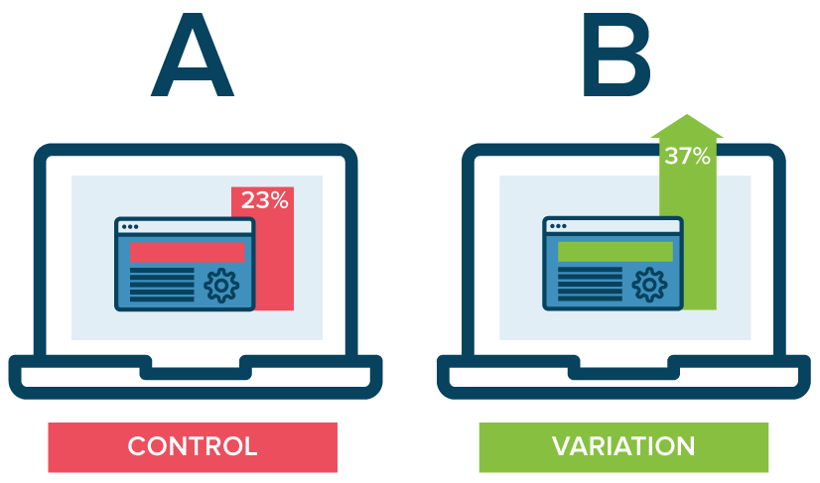
A/B testing
https://vwo.com/

Slide 4
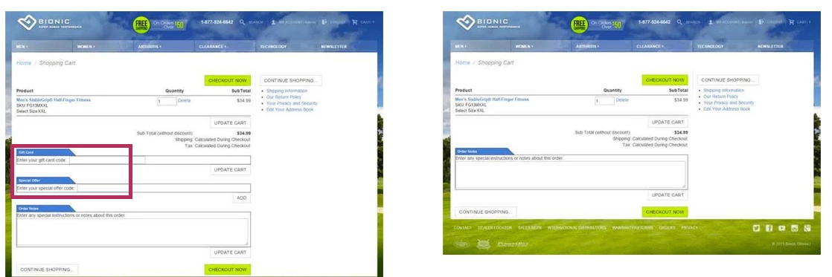
A/B testing - Case Study
Removing Promo-code Boxes from Checkout Page Increased Total Revenue by 24.7%
https://vwo.com/blog/10-kickass-ab-testing-case-studies/

Slide 5


Playing golf – What influences a score?
The type of driver used (oversized or regular size)
The type of ball used (balata or three pieces)
Walking and carrying the golf clubs or riding in a golf cart
Drinking water or drinking beer while playing
Playing in the morning or playing in the afternoon
Playing when it is cool or playing when it is hot
The type of golf shoe spike worn (metal or soft)
Playing on a windy day or playing on a calm day
Montgomery, D.C., 2009. Design and analysis of experiments. John Wiley & sons.

Slide 6
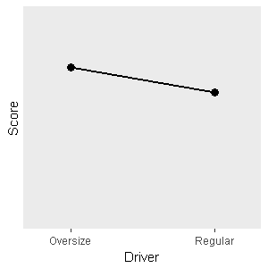
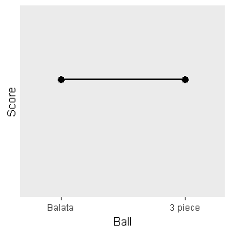
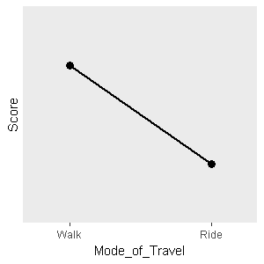
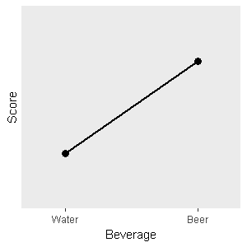
One-factor-at-a-time strategy
T-Test

Slide 7
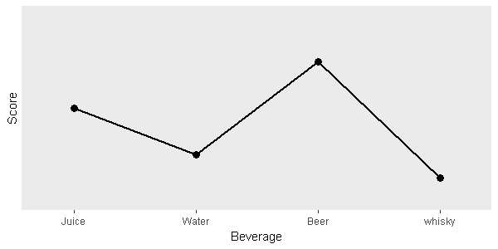
One-factor-at-a-time strategy
ANOVA

Slide 8
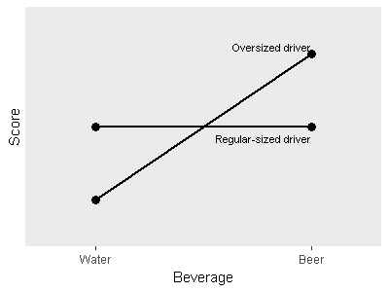
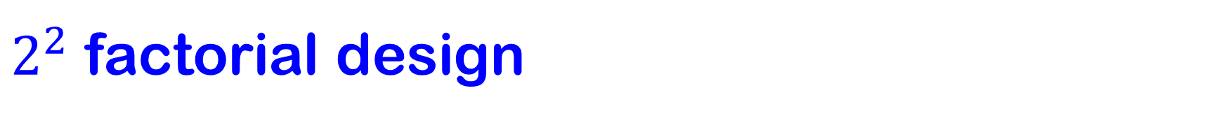
$2^{2}$ factorial design
Interaction between type of driver and type of beverage for golf experiment

Slide 9
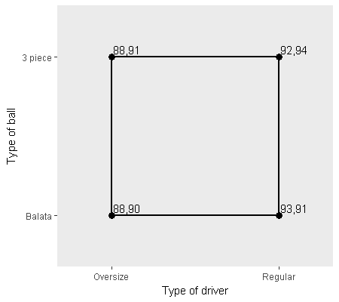
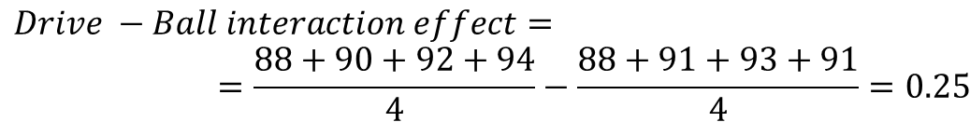
$2^{2}$ factorial design
$$Driver effect=\frac{92+94+93+91}{4}−\frac{88+91+88+90}{4}=3.25$$
$$Ball effect=\frac{88+91+92+94}{4}−\frac{88+90+93+91}{4}=0.75$$
$$Drive −Ball interaction effect=$$
$$=\frac{88+90+92+94}{4}−\frac{88+91+93+91}{4}=0.25$$

Slide 10
Recall Playing golf experiment
The type of driver used (oversized or regular size)
The type of ball used (balata or three pieces)
Walking and carrying the golf clubs or riding in a golf cart
Drinking water or drinking beer while playing
Playing in the morning or playing in the afternoon
Playing when it is cool or playing when it is hot
The type of golf shoe spike worn (metal or soft)
Playing on a windy day or playing on a calm day
Montgomery, D.C., 2009. Design and analysis of experiments. John Wiley & sons.

Slide 11
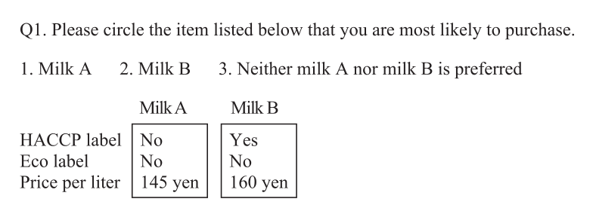
Discrete (Stated) Choice Experiment
3 factors:
HACCP label (Yes/No)
Eco label (Yes/No)
Price (145, 150, 155, or 160 yen)
Aizaki, H. and Nishimura, K., 2008. Design and analysis of choice experiments using R: a brief introduction. Agricultural Information Research, 17(2), pp.86-94.

Slide 12
Full Factorial Design
R> library(AlgDesign)
R> ffd <- gen.factorial(c(2,2,4), varNames = c("HAC", "ECO", "PRI"), factors = "all")
R> ffd
HAC ECO PRI
1 1 1 1
2 2 1 1
3 1 2 1
4 2 2 1
5 1 1 2
6 2 1 2
7 1 2 2
8 2 2 2
9 1 1 3
10 2 1 3
11 1 2 3
12 2 2 3
13 1 1 4
14 2 1 4
15 1 2 4
16 2 2 4

Slide 13
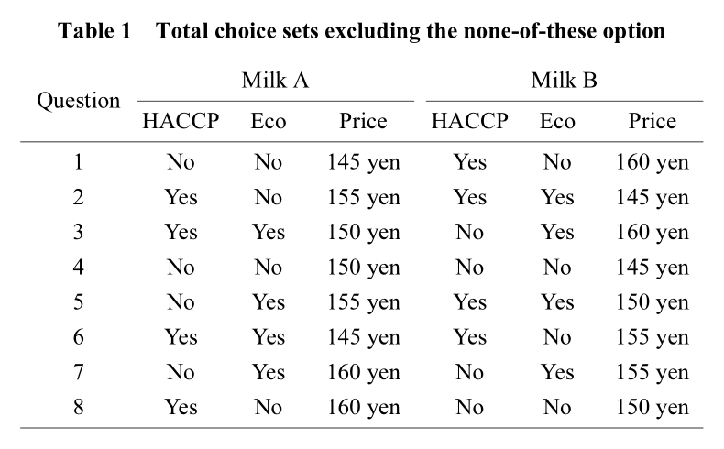
Fractional Factorial Design

Slide 14
Discrete Choice Experiment
Consider a product with the following three attributes:
The region of origin: Region A, Region B, Region C
The eco-friendly label: “Conv.” (conventional cultivation method), “More” (more eco-friendly cultivation method), and “Most” (most eco-friendly cultivation method)
The price per piece of the product: $1, $1.1, $1.2
Aizaki, H., 2012. Basic functions for supporting an implementation of choice experiments in R. Journal of statistical software, 50, pp.1-24.

Slide 15
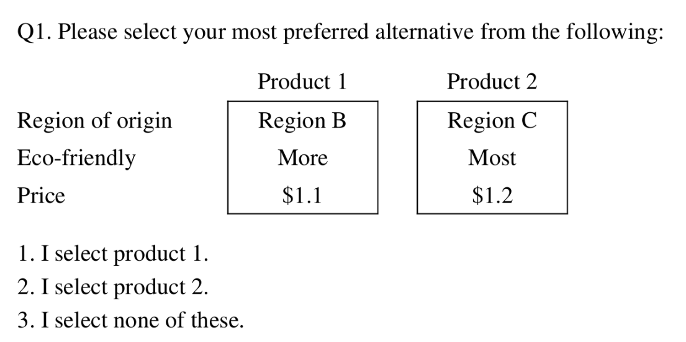
Design

Slide 16
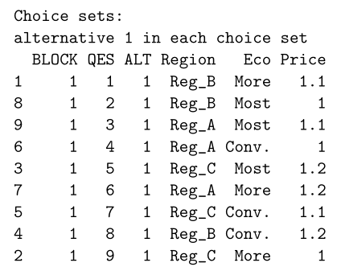
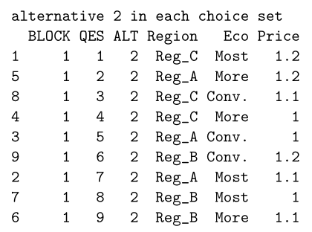
Design
R> library(support.CEs)
R> des1 <- rotation.design(attribute.names = list(
+ Region = c("Reg_A", "Reg_B", "Reg_C"),
+ Eco = c("Conv.", "More", "Most"),
+ Price = c("1", "1.1", "1.2")),
+ nalternatives = 2, nblocks = 1, row.renames = FALSE,
+ randomize = TRUE, seed = 987)

Slide 17
Design
R> questionnaire(choice.experiment.design = des1)
Block 1
Question 1
alt.1 alt.2
Region "Reg_B" "Reg_C"
Eco "More" "Most"
Price "1.1" "1.2"
Question 2
alt.1 alt.2
Region "Reg_B" "Reg_A"
Eco "Most" "More"
Price "1" "1.2"
...

Slide 18
Collected data
R> data("syn.res1")
R> syn.res1[1:3, ]
ID BLOCK q1 q2 q3 q4 q5 q6 q7 q8 q9 F
1 1 1 2 1 2 2 2 1 2 3 1 0
2 2 1 1 1 1 1 3 1 3 2 2 1
3 3 1 1 2 1 2 2 3 3 3 1 0
R> desmat1 <- make.design.matrix(choice.experiment.design = des1,
+ optout = TRUE, categorical.attributes = c("Region", "Eco"),
+ continuous.attributes = c("Price"), unlabeled = TRUE)
R> desmat1[1:3, ]
BLOCK QES ALT ASC Reg_B Reg_C More Most Price
1 1 1 1 1 1 0 1 0 1.1
2 1 1 2 1 0 1 0 1 1.2
3 1 1 3 0 0 0 0 0 0.0

Slide 19
Collected data
R> dataset1 <- make.dataset(respondent.dataset = syn.res1,
+ choice.indicators =
+ c("q1", "q2", "q3", "q4", "q5", "q6", "q7", "q8", "q9"),
+ design.matrix = desmat1)
> dataset1[1:10, ]
ID F BLOCK QES ALT RES ASC Reg_B Reg_C More Most Price STR
1 1 0 1 1 1 FALSE 1 1 0 1 0 1.1 101
2 1 0 1 1 2 TRUE 1 0 1 0 1 1.2 101
3 1 0 1 1 3 FALSE 0 0 0 0 0 0.0 101
4 1 0 1 2 1 TRUE 1 1 0 0 1 1.0 102
5 1 0 1 2 2 FALSE 1 0 0 1 0 1.2 102
6 1 0 1 2 3 FALSE 0 0 0 0 0 0.0 102
7 1 0 1 3 1 FALSE 1 0 0 0 1 1.1 103
8 1 0 1 3 2 TRUE 1 0 1 0 0 1.1 103
9 1 0 1 3 3 FALSE 0 0 0 0 0 0.0 103
10 1 0 1 4 1 FALSE 1 0 0 0 0 1.0 104

Slide 20
Analysis - clogit
R> library(survival)
R> clogout1 <- clogit(RES ~ ASC + Reg_B + Reg_C + More + Most +
Price + strata(STR), data = dataset1)
R> clogout1 <- clogit(RES ~ ASC + Reg_B + Reg_C + More + Most + More:F +
Most:F + Price + strata(STR), data = dataset1)

Slide 21
Analysis - clogit
R> clogout1
Call:
clogit(RES ~ ASC + Reg_B + Reg_C + More + Most + More:F + Most:F +
Price + strata(STR), data = dataset1)
coef exp(coef) se(coef) z p
ASC 4.665534 106.222257 0.732995 6.365 1.95e-10
Reg_B -0.595147 0.551481 0.131668 -4.520 6.18e-06
Reg_C -0.351841 0.703392 0.114489 -3.073 0.002118
More 0.596685 1.816089 0.165580 3.604 0.000314
Most 0.794075 2.212394 0.149033 5.328 9.92e-08
Price -4.750742 0.008645 0.668057 -7.111 1.15e-12
More:F -0.031762 0.968737 0.195998 -0.162 0.871265
Most:F 0.026287 1.026636 0.173427 0.152 0.879523
Likelihood ratio test=133.6 on 8 df, p=< 2.2e-16
n= 2700, number of events= 900
Results interpretation is the same as in “normal” Logistic Regression Analysis

Slide 22
Analysis – goodness of fit
R> gofm(clogout1)
Rho-squared = 0.06753386
Adjusted rho-squared = 0.05944284
Akaike information criterion (AIC) = 1859.954
Bayesian information criterion (BIC) = 1898.373
Number of coefficients = 8
Log likelihood at start = -988.7511
Log likelihood at convergence = -921.9769

Slide 23
Analysis – Marginal Willingness to Pay (MWTP)
R> mwtp(output = clogout1, monetary.variables = c("Price"),
nonmonetary.variables = c("Reg_B", "Reg_C", "More", "Most", "More:F",
"Most:F"), confidence.level = 0.90, seed = 987)
MWTP 5% 95%
Reg_B -0.125275 -0.179092 -0.079732
Reg_C -0.074060 -0.122267 -0.033051
More 0.125598 0.068330 0.192828
Most 0.167148 0.112204 0.239471
More:F -0.006686 -0.076040 0.061941
Most:F 0.005533 -0.056513 0.067328
method = Krinsky and Robb

Slide 24
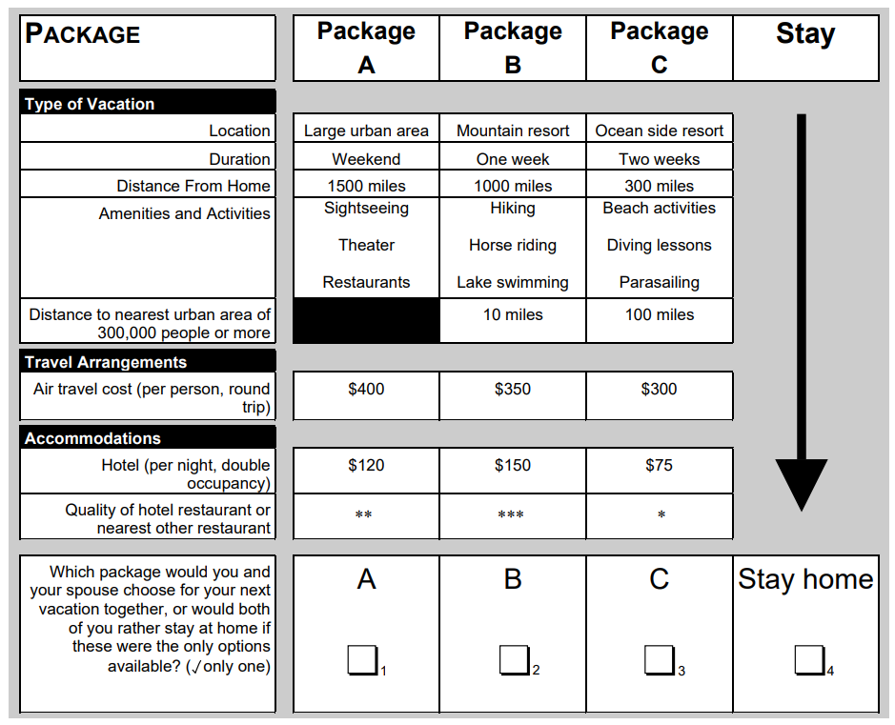
Examples of choice experiment
Louviere, J.J., Hensher, D.A. and Swait, J.D., 2000. Stated choice methods: analysis and applications. Cambridge university press.

Slide 25
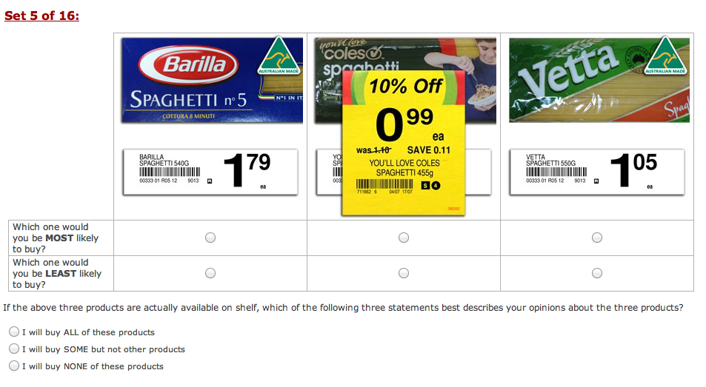

Slide 26
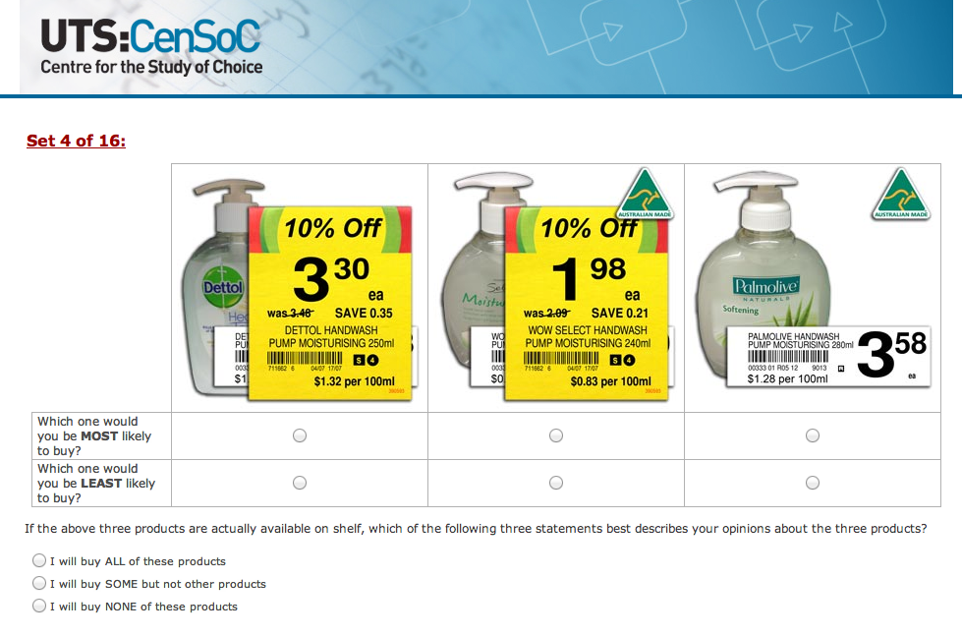

Slide 27
References
Aizaki, H. and Nishimura, K., 2008. Design and analysis of choice experiments using R: a brief introduction. Agricultural Information Research, 17(2), pp.86-94.
Aizaki, H., 2012. Basic functions for supporting an implementation of choice experiments in R. Journal of statistical software, 50, pp.1-24.
Montgomery, D.C., 2009. Design and analysis of experiments. John Wiley & Sons.
Louviere, J.J., Hensher, D.A. and Swait, J.D., 2000. Stated choice methods: analysis and applications. Cambridge university press.
Kuhfeld, WF. Marketing Research Methods in SAS. 2010 http://support.sas.com/resources/papers/tnote/tnote_marketresearch.html You need file “2010C” and then “2010F”
Bierlaire, M. (2018). PandasBiogeme: a short introduction. Technical report TRANSP-OR 181219. Transport and Mobility Laboratory, ENAC, EPFL. http://biogeme.epfl.ch/

Slide 28
Summary
Causal research as a part of Descriptive Analytics
Experiment design
A/B testing
Discrete choice experiments
Full and partial factorial design
Design, data collection, analysis, interpretation
Marginal willingness to pay

Slide 29
Thank you

